Slide 1



SALARIES & NEGOTIATION
WHAT TO KNOW AS A JUNIOR PROFESSIONAL
2023 | REMOTE CAMPUSES

Slide 2


Important things to keep in mind
1. Salary negotiation happens after extending an offer It is the very last stage of the interview process when they are sure they WANT you on the team.
2. Conversations about the salary range normally appear earlier in the interview process. So you need to be prepared to talk about your range.
3. Negotiation is just a conversation to align on your needs and those of your employer. It is a normal part of the process.
Notes:
Salary negotiation happens after extending an offer (the very last stage of the interview process when they are sure they WANT you on the team)
Conversations about the salary range might appear earlier in the interview process, so you need to be prepared to talk about your range
Negotiation is just a conversation to align on your and employers needs. It is a normal part of the process. It will give you credibility and make it easy for the recruiter or hiring manager to see your point.

Slide 3
Important things to keep in mind
4. Salary negotiation can differ depending on the market and country you are searching for a job. E.g. Germany vs France
There are countries with public salaries (UK). It makes the deal easier.
5. You have less flexibility to negotiate as a junior or in your very first job. But you need to be aware of salaries to not get underpaid.
6. ALWAYS negotiate in person (not via email) but have the offer in a written way.
Notes:
4. Salary negotiation can differ depending on the market and country you are searching for a job.
E.g. Germany vs France
There are countries with public salaries (UK). It makes the deal easier.
5. You have less flexibility to negotiate as a junior or in your very first job. But you need to be aware to not get underpaid.
6. ALWAYS negotiate in person (not via written way) but have the offer in a written way. (as a proof).

Slide 4
Important things to keep in mind
7. If they can’t offer more, ask for future salary changes.
It can be a planned time to reassess your salary or a planned increase after some predetermined amount of time.
8. Consider other ways the employer could compensate you that would be valuable to you.

Slide 5
Some practical tips on negotiation
Use kind and soft language. I am wondering if the number is flexible. I would be more comfortable with 40K. Is there any room for growth?
Use the sentences: “based on my research…”, “How flexible is that number?”...
Take your time to think Remember that you don't have to say yes or no straight away. Take time to think about the offer and ask for it to be sent in a written form.
If you feel that the offer is off, they are not flexible to negotiate and other benefits don't convince you, it's ok to politely decline.
Notes:
Extra resources: https://www.glassdoor.com/blog/words-phrases-to-use-salary-negotiations/

Slide 6



Examples of non-financial incentives
Flexible working hours
Extra annual leave
Training/Professional development

Slide 7

Examples of non-financial incentives
Working from home

Slide 8



How to prepare for salary questions?
STEP 1
STEP 2
STEP 3
Do your research on salary ranges in your area for the specific position.
Know your salary range that is aligned with your needs and the market value. Choose range instead of a certain number.
Collect evidence Ask agency recruiters, other Ironhackers and people you know in the industry what the industry salary is.

Slide 9

STEP 1: Research the salary range
Check this link to find Salary research sites (Comparably, RepVue, Levels.fyi…) or Go to glassdoor.com/Salaries
(alternatives - Kununu (Germany), Indeed, Payscale…)
Search by a specific job title & location F.e. Junior Web Developer & Barcelona
If you are applying for a specific company you can also see the employee company & salary reviews about it (i.e Glassdoor)
Notes:
| Glassdoor, Fairy God Boss , Career Bliss, The Job Crowd (UK), Comparably, Kununu (GER) More salary websites: https://www.moneyunder30.com/best-salary-information-websites

Slide 10

STEP 2: Calculate your salary range Example:
What are your expenses? F.e. rent + family & other expenses: 1000 eur per month (you need this for living) + buffer or savings 500 eur. So your lowest salary will be 1500 net/month. (you will not go lower than your needs)
What is your previous / current or desired salary? Let's say 1700 net month.
How it compares with the market value? The market average is around 1400-1700 net month. So your range might be 1600 -2000 net month.
Convert it to the yearly gross salary (if necessary).

Slide 11

STEP 3: Collect Evidence Speak to people to learn more about the latest industry updates, including salary ranges. Good people to ask to:
Recruiters, especially agency/external recruiters
Ex-Ironhackers who landed jobs
People you know personally in similar roles, also more senior professionals who started in junior roles.
Notes:
More salary websites: https://www.moneyunder30.com/best-salary-information-websites

Slide 12
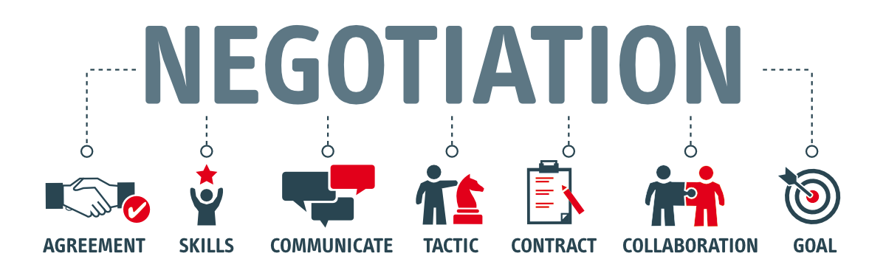
And what can YOU offer?
To negotiate, you need to know your value and show you are worth it. To do so:
Read the job description carefully once again and highlight your skills and abilities they are looking for
Highlight "good to haves", your previous experience, any added value that distinguishes you from others
You gain extra points if you did very well on the challenge - it can increase your chances for the higher end of the salary
If you have another offer, you can mention that but remember to highlight that you want this job more if that is true.

Slide 13

Example
Notes:
See an discuss an example on how to negotiate the salary.

Slide 14

Example
Notes:
See an discuss an example on how to negotiate the salary.

Slide 15


